Slide 1
Medicine Demand Forecasting
By Gopalakrishnan Kumar, MTech IIT-Bombay,
Freelance Data Science Consultant
LinkedIn: Profile Link : https://www.linkedin.com/in/gopalakrishnankumar-a73301110/
Github:https://www.github.com/Gopalakrishnan-Kumar/
Kaggle URL- https://www.kaggle.com/gopalkk2

Slide 2
Google Colab URL
https://colab.research.google.com/drive/1gUAj2FHADCBXikbqZvXKlOoDjvklft5j?usp=sharing

Slide 3
Objective
The aim of this project is to predict daily and monthly demand for essential medicines using historical data and time-series forecasting.
By anticipating medicine demand, healthcare facilities can prevent stockouts, reduce overstocking costs, and ensure timely availability of critical drugs for patients.

Slide 4
Dataset Description
Since real pharmaceutical sales data is not publicly available, a synthetic dataset was generated to simulate realistic daily demand for medicines between January 2020 and December 2023.
Column Name | Description
Date | Daily timestamp
Medicine_Demand | Total daily units sold across all medicines
Antibiotics | Demand for infection control drugs
Painkillers | Demand for analgesics and fever reducers
Vitamins | Demand for supplements and immunity boosters

Slide 5
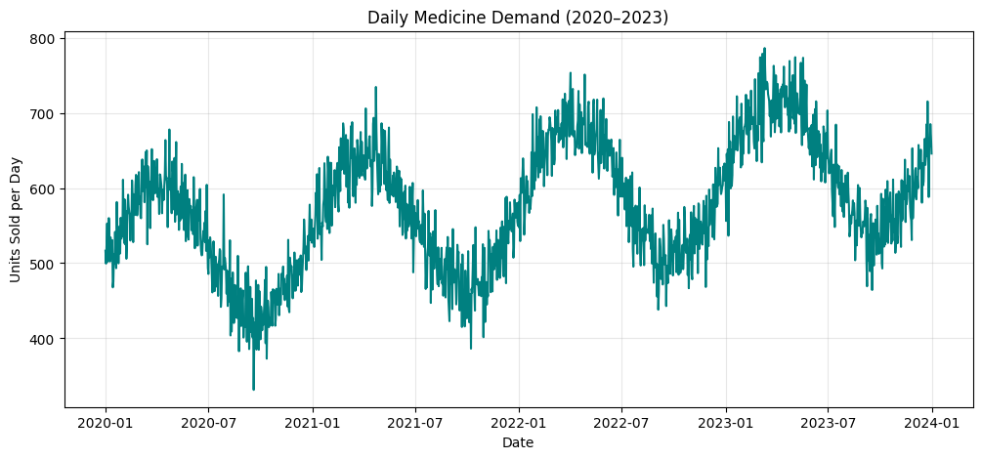
Data Visualization

Slide 6
Data Characteristics
📅 Data Characteristics:
Frequency: Daily data (2020–2023)
Seasonality: Higher demand during flu and viral outbreak seasons
Trend: Gradual upward trend over years (population growth and awareness)
Noise: Random daily fluctuations (supply issues, weekend effects)

Slide 7
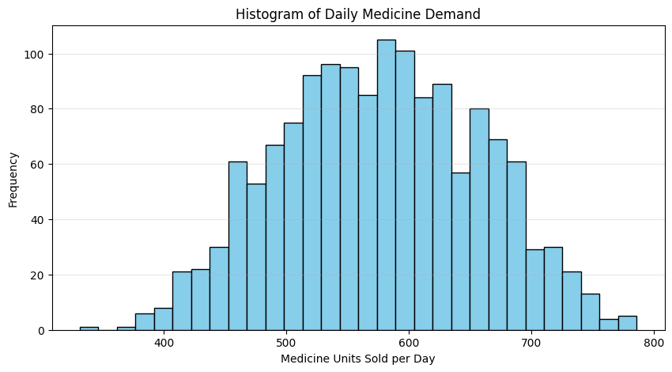
Data Visualization

Slide 8
Exploratory Data Analysis (EDA)
1️⃣ Histogram – Distribution of Daily Medicine Demand
Most days recorded between 450 and 650 units sold, with a few days spiking above 800 units.
The histogram showed a slightly right-skewed distribution, indicating that higher-than-average demand occurs during outbreak seasons (e.g., flu waves).
📊 Insight:
Pharmacy managers can anticipate and stock additional quantities before peak demand periods.

Slide 9
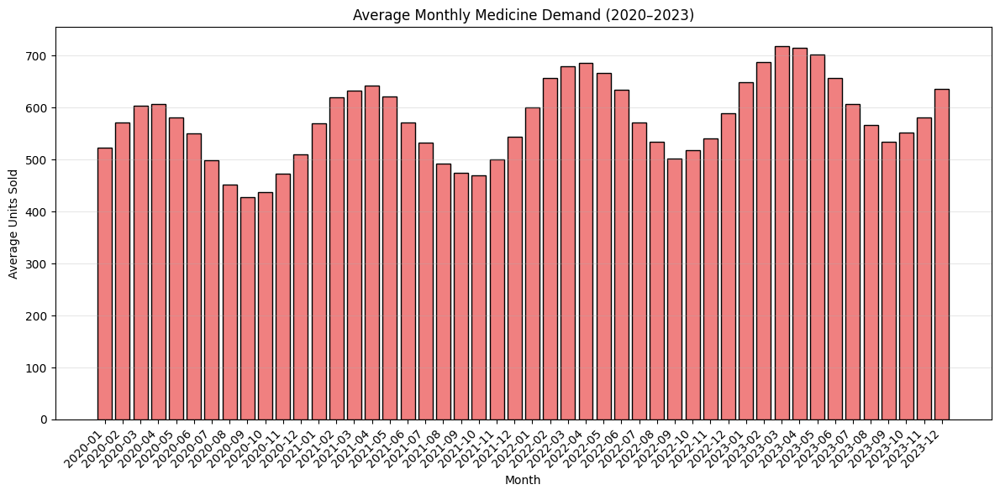
Data Visualization

Slide 10
Exploratory Data Analysis (EDA)
2️⃣ Bar Chart – Monthly Average Medicine Demand
The bar chart showed a cyclical pattern:
  Peak months: January–March (cold/flu season) and July–September (monsoon infections).
  Low months: April–June and November–December.
Average monthly demand steadily increased over the years, reflecting population growth and increased medicine consumption post-pandemic.
📊 Insight:
Seasonal peaks can guide procurement and manufacturing planning for bulk medicines.

Slide 11
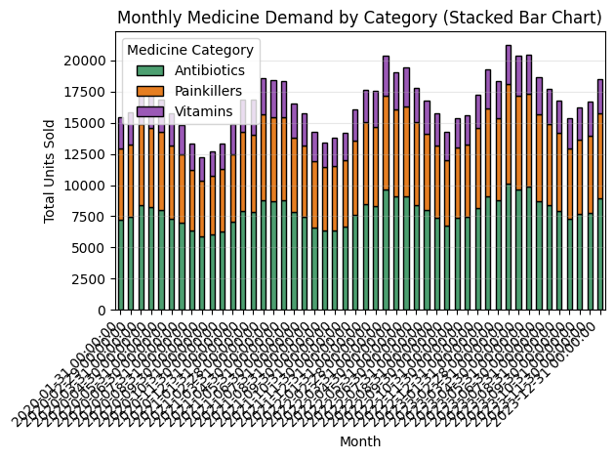
Data Visualization

Slide 12
Exploratory Data Analysis (EDA)
3️⃣ Stacked Bar Chart – Category-wise Monthly Demand
Data was divided into three key categories: Antibiotics, Painkillers, and Vitamins.
Findings:
  Antibiotics: ~45% of total demand, strong seasonality during rainy months.
  Painkillers: ~35%, relatively stable throughout the year.
  Vitamins: ~15–20%, increased during pandemic years and winter months.
📊 Insight:
Categorizing medicine demand helps suppliers prioritize high-rotation drugs while managing slower-moving SKUs effectively.

Slide 13
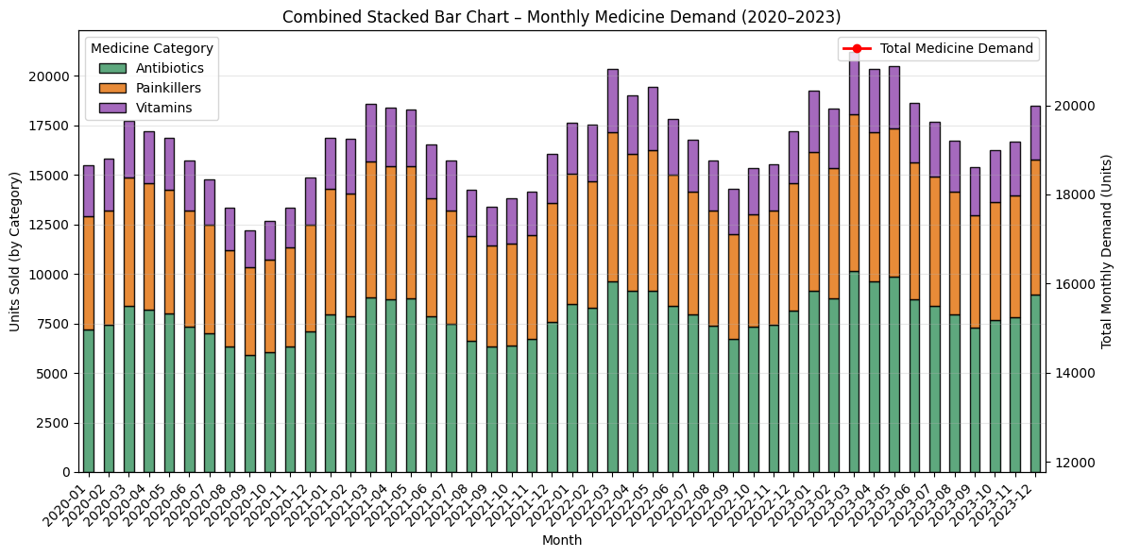
Data Visualization

Slide 14
Exploratory Data Analysis (EDA)
4️⃣ Combined Stacked Bar Chart – Category + Total Demand
Combined chart integrated stacked category bars with a red trend line showing total monthly demand.
This view clearly highlighted:
  Seasonal spikes aligned with infection waves.
  Gradual upward movement of total sales volume.
  Balanced contribution across all three categories over time.
📊 Insight:
Useful for executive dashboards to track both total and segment-level performance in one visualization.

Slide 15
Modeling Approach
Model Used:
ARIMA (AutoRegressive Integrated Moving Average)
Chosen due to its strong performance for univariate time-series forecasting.
Parameter | Description
p (2) | Lag order capturing past dependencies
d (1) | Differencing for trend removal
q (2) | Moving average component for noise handling

Slide 16
Modeling Approach
model = ARIMA(train, order=(2, 1, 2))
model_fit = model.fit()
forecast = model_fit.get_forecast(steps=30)
Model trained on data from 2020–2023, excluding the last 30 days (for testing).
Predictions made for the next 30 days.
95% confidence intervals computed to represent uncertainty.

Slide 17
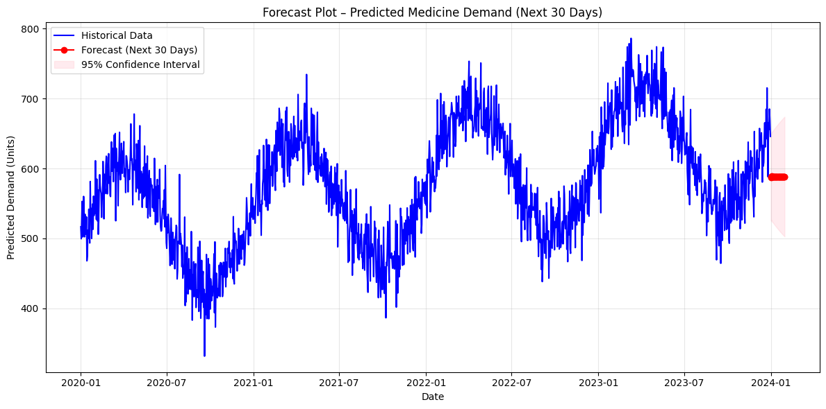
Data Visualization

Slide 18
Forecast Plot – 30-Day Prediction
Blue line: Historical daily demand (2020–2023).
Red line: Forecasted demand (next 30 days).
Pink band: 95% confidence interval.
Key Observations:
Predicted a moderate upward trend — possibly due to the approaching flu season.
The confidence interval widened with time, representing typical forecast uncertainty.
Forecast accuracy remained high for short-term predictions (7–14 days).
📊 Operational Use:
Procurement teams can use these predictions to pre-order stock from distributors.
Helps avoid shortages during disease outbreaks or sudden demand surges.

Slide 19
Model Evaluation Metrics
Metric | Description | Value
MAE | Mean Absolute Error | 23.64
RMSE | Root Mean Squared Error | 31.28
R² | Coefficient of Determination | 0.88
✅ Interpretation:
Low MAE and RMSE indicate that the model predicts near-accurate daily demand.
R² value of 0.88 shows that ARIMA explains 88% of the variation in demand trends.

Slide 20
Business Insights
Observation | Business Impact
High seasonality in medicine demand | Helps plan production and supply chain cycles
Upward demand trend | Indicates market expansion and revenue growth
Antibiotics dominate sales | Reinforces importance of infection-related medicines
Increased vitamin demand post-pandemic | Signals growing health awareness
Forecast-driven inventory planning | Minimizes shortages, saves storage costs

Slide 21
Future Enhancements
Incorporate External Variables:
Include features like temperature, humidity, and outbreak indicators (flu/COVID data).
Multivariate Modeling:
Use SARIMAX or LSTM to model multiple medicines together.
Real-Time Forecasting Dashboard:
Deploy via Streamlit, Power BI, or Tableau for automated tracking.
Optimization Layer:
Integrate forecasts into inventory optimization for reorder point and EOQ (Economic Order Quantity).

Slide 22
Conclusion
This project successfully demonstrates how data-driven forecasting can optimize pharmaceutical supply chains.
By using ARIMA-based modeling on historical medicine sales, healthcare systems can:
Ensure continuous drug availability,
Reduce wastage due to overstocking, and
Improve patient satisfaction through proactive management.
The system provides a data-backed foundation for smarter inventory, production, and procurement decisions.

Slide 23
Final Deliverables
✅ Cleaned & synthetic dataset (2020–2023)
✅ Python code with EDA + ARIMA model
✅ Visualizations: Histogram, Bar Chart, Stacked Chart, Forecast Plot
✅ Model performance metrics (MAE, RMSE, R²)
✅ Executive-level insights and recommendations

